Slide 1
NodeMCU-ESP8266 and IoT applications

Slide 2
Index
About NodeMCU-ESP 8266 Board
Arduino IDE and IoT and sensor libraries Installation
Wifi connection establishment
Blynk IoT cloud programming

Slide 3
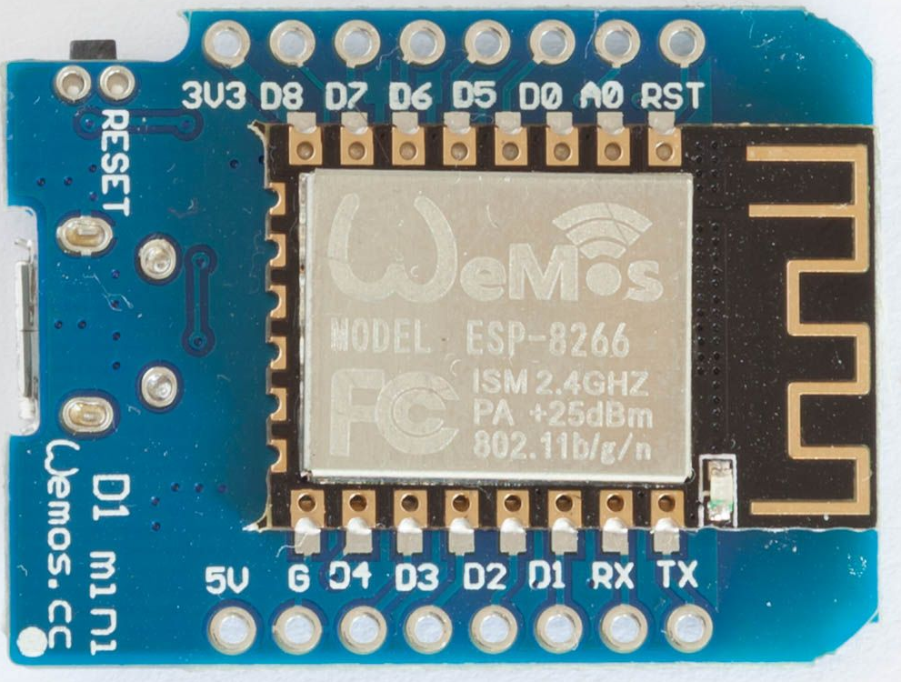
ESP8266 wemos D1 mini board
Front view:
It has 16 pins and a WiFi antenna.

Slide 4
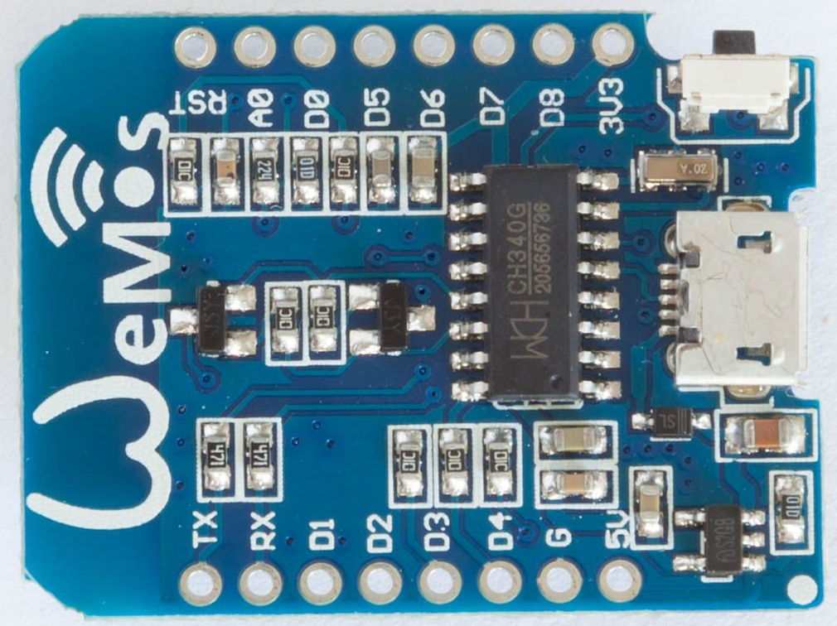
ESP8266 wemos D1 mini board
Rear view:
micro USB connector,
a USB to serial interface "CH340G"
a voltage regulator
a reset button
a 12MHz resonator
a fuse

Slide 5
ESP8266 WeMos D1 Mini Board Specifications
a single core 32-bit CPU that runs at 80 MHz
4MB Flash
3.0 ~ 3.6V (recommendation 3.3V)
80mA Nominal working current
802.11 b / g / n
2.4GHz-2.5GHz (2400M-2483.5M), PCB trace antenna
UART / HSPI / I2C / I2S / Ir Remote Control / GPIO / PWM
24 x 16mm PCB, 2x8 castellated connections
Operating temperature: -40°C ~ 125°C

Slide 6
ESP8266 WeMos D1 Mini Board
Processor | Tensilica Xtensa Diamond 32-bit
Operating Voltage | 3.3V
Power Supply via VIN,VCC | 4V...6V
Digital I/O Pins (with PWM) | 11 (11)
Analog Input Pins | 1
Resolution ADC | 10 bit (0...1023)
Analog Output Pins | 0
SPI/I2C/I2S/UART | 1/1/1/1
Max DC Current per I/O Pin | 12 mA

Slide 7
WeMos D1 Mini Board
Flash Memory | 4 MB
SRAM | 64 KB
EEPROM | 512 bytes
Clock Speed | 80/160 MHz
WIFI | IEEE 802.11 b/g/n
USB connection
Programmable | Arduino IDE, LuaNode SDK, Micropython
3.3V Voltage Regulator | ME6211
Maximum Output Current | 500mA
Typical Quiescent Current | 0.1µA
Light Sleep [mA] | 0.68
Deep Sleep [mA] | 0.17

Slide 8
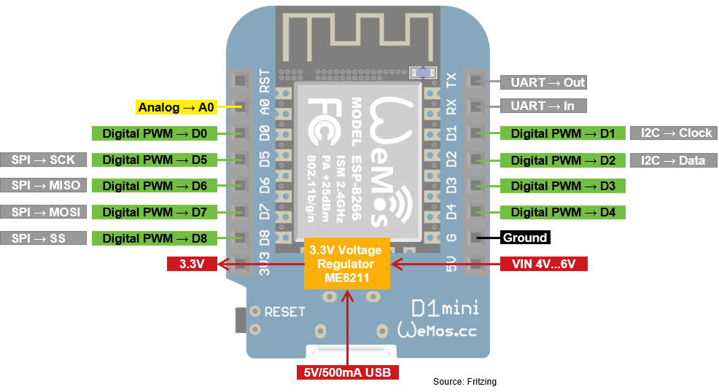
Pin Diagram

Slide 9
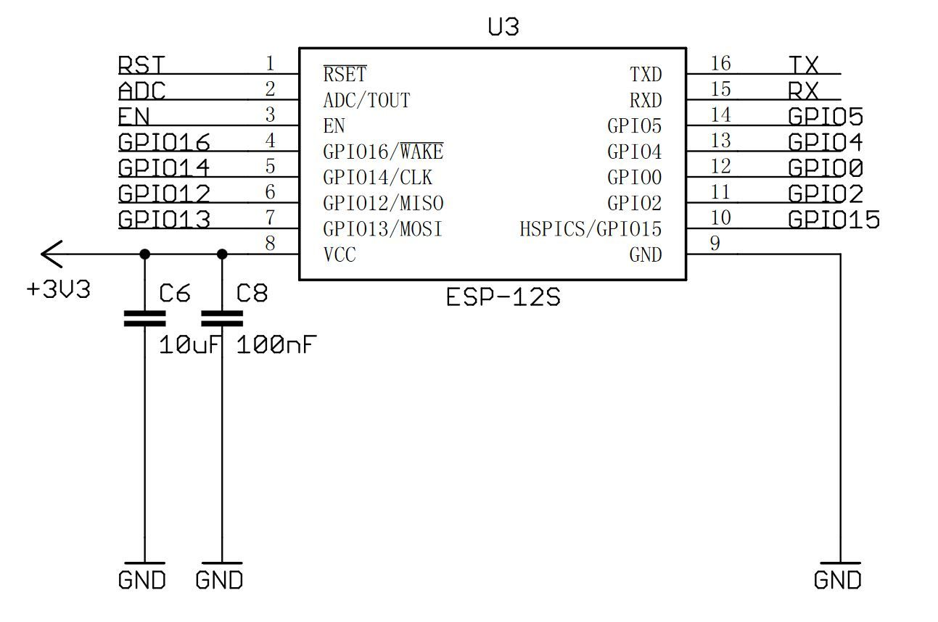
Power Supply Connections on board

Slide 10
CH340G – Serial interface
an USB to UART interface.
It provides a virtual serial port to a PC.
The role of this chip is to make communication with the ESP8266 easier.

Slide 11
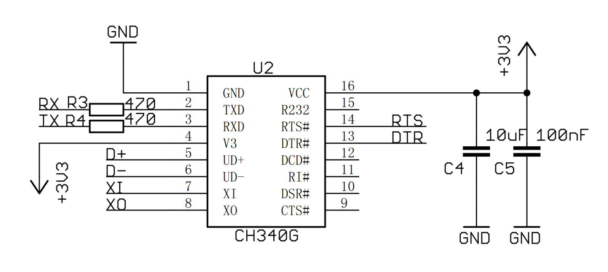
ESP8266 WeMos D1 Mini Voltage Regulator

Slide 12
ESP8266 WeMos D1 Mini Voltage Regulator
ME6211 3.3V voltage regulator is connected to the 5V pin and the USB port.
The maximum input voltage of the ME6211 is 6V (USB input voltage is 5V)
The maximum output current of the voltage regulator is 500mA that is also the maximum current for a USB power supply.

Slide 13
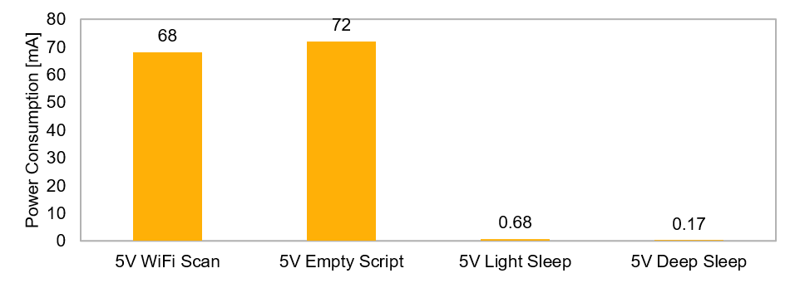
ESP8266 WeMos D1 Mini Power Consumption

Slide 14
Programming of ESP8266 WeMos D1 Mini
Programming Platforms
Arduino IDE
LuaNode SDK
Micropython

Slide 15
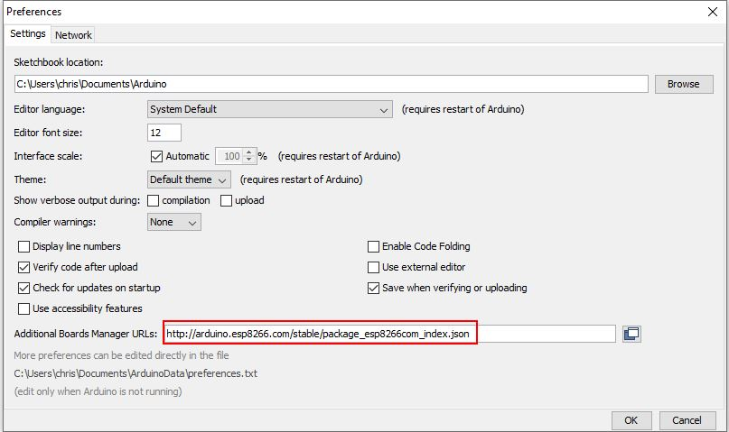
Arduino IDE programming steps
In the Arduino IDE menu click on File → Preferences
Insert the following URL in the field “Additional Boards Manager URLs:”:
http://arduino.esp8266.com/stable/package_esp8266com_index.json

Slide 16
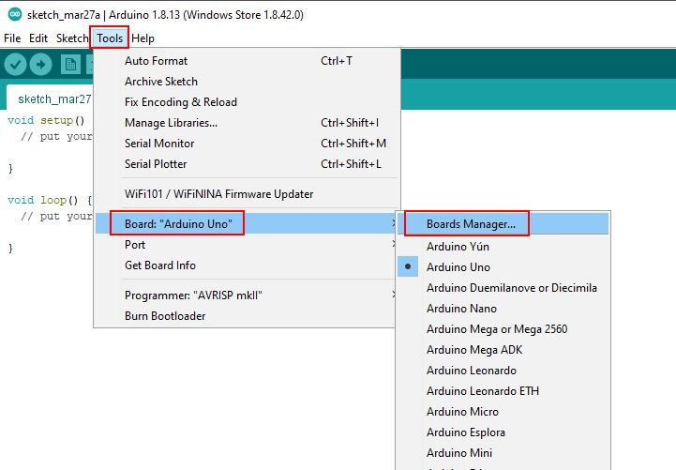
Installing the necessary packages for the ESP8266 module:
Click in the Arduino IDE on Tools → Board → Board Manager.
Now search for NodeMCU or ESP8266 and you will find the esp8266 by ESP8266 Community.
Install the latest version of the board.

Slide 17
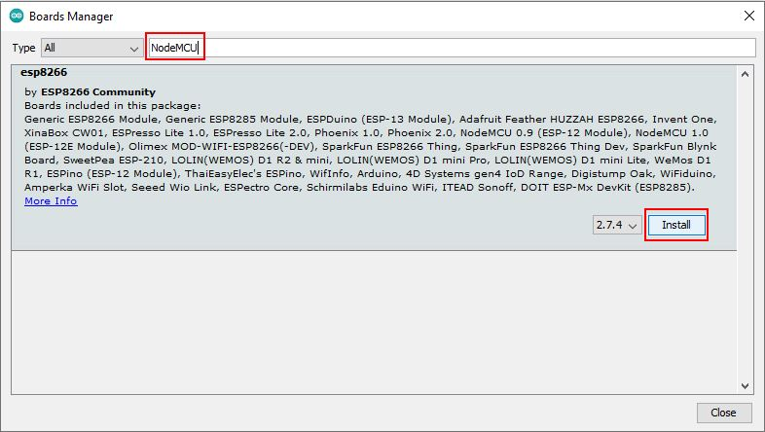
Installing the necessary packages for the ESP8266 module:

Slide 18
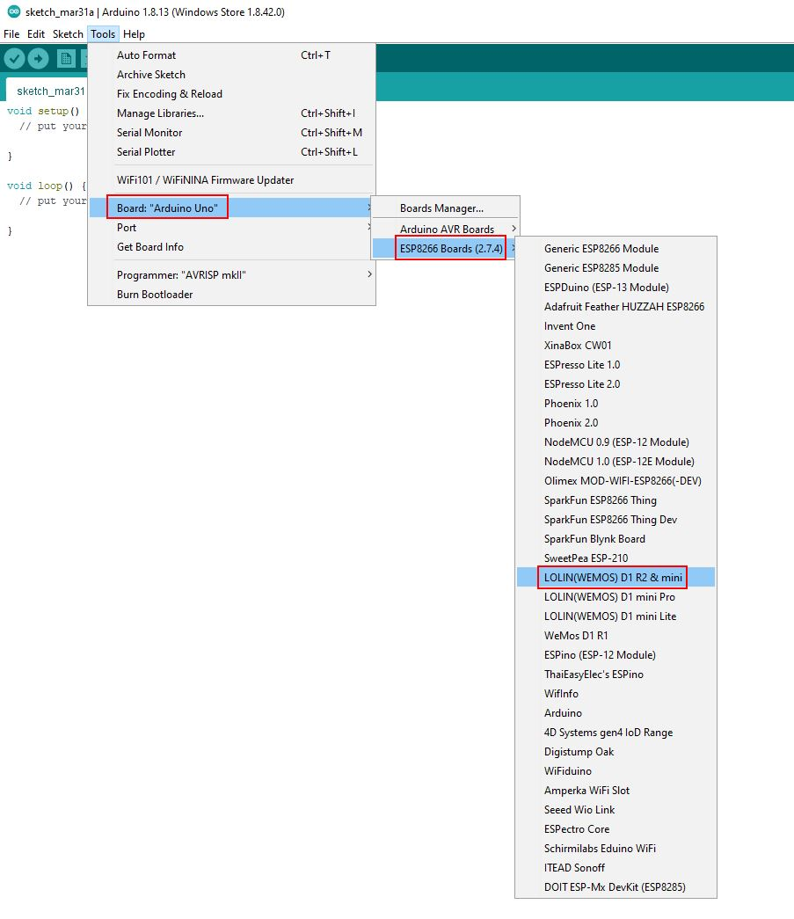
Board selection for programming of ESp8266 board
After the installation you can select the ESP8266 WeMos D1 Mini that has the name “LOLIN(WEMOS) D1 R2 & mini” under Tools → Board.

Slide 19
Wifi Connection…
#include <ESP8266WiFi.h> // Include the Wi-Fi library
const char* ssid = "SSID"; // The SSID (name) of the Wi-Fi network you want to connect to
const char* password = "PASSWORD"; // The password of the Wi-Fi network

Slide 20
Wifi Connection…
void setup() {
Serial.begin(115200); // Start the Serial communication to send messages to the computer
delay(10);
Serial.println('\n');
WiFi.begin(ssid, password); // Connect to the network
Serial.print("Connecting to ");
Serial.print(ssid); Serial.println(" ...");
int i = 0;
while (WiFi.status() != WL_CONNECTED) { // Wait for the Wi-Fi to connect
delay(1000);
Serial.print(++i); Serial.print(' ');
}

Slide 21
Wifi Connection…
Serial.println('\n');
Serial.println("Connection established!");
Serial.print("IP address:\t");
Serial.println(WiFi.localIP()); // Send the IP address of the ESP8266 to the computer
}

Slide 22
Output on the serial monitor
Connecting to SSID ...
1 2 3 4 5 6 ...
Connection established!
IP address: 192.168.1.3

Slide 23
Set up Blynk IoT Cloud
Create Blynk Template
Create Datastreams in the Blynk cloud
Create Web Dashboard
Add Device in Blynk Cloud using Template
Program NodeMCU with Arduino IDE
Modify the main code for IoT.

Slide 24
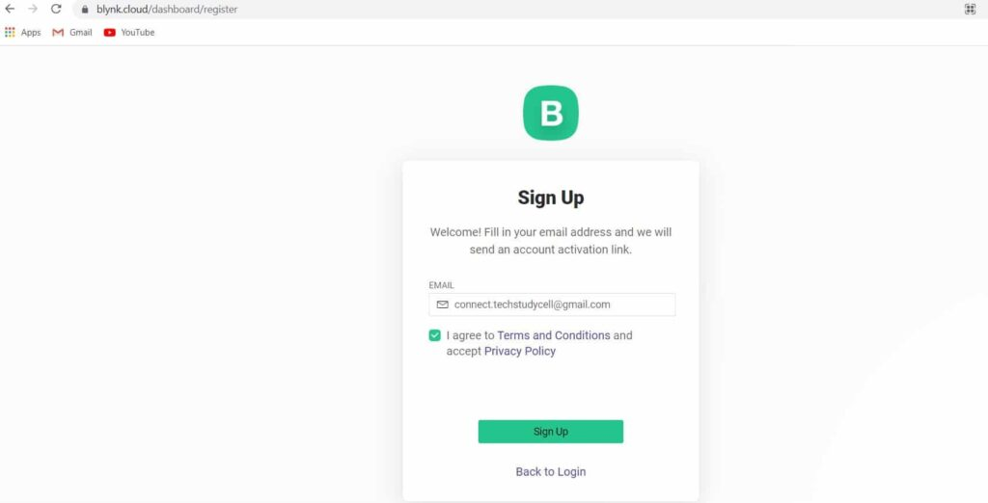
Create Blynk Template
Create an account in Blynk IoT Cloud Platform
create an account in Blynk cloud platform
https://blynk.cloud/dashboard/register
Enter your email ID and click on Sign Up.
After that, you will receive a verification email from Blynk.
In that email click on Create Password to set the password for Blynk cloud account.

Slide 25
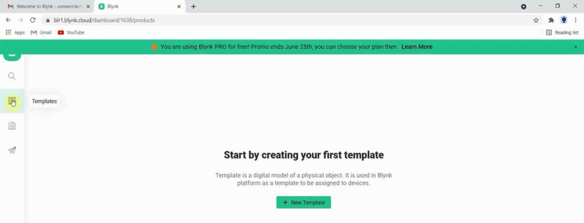
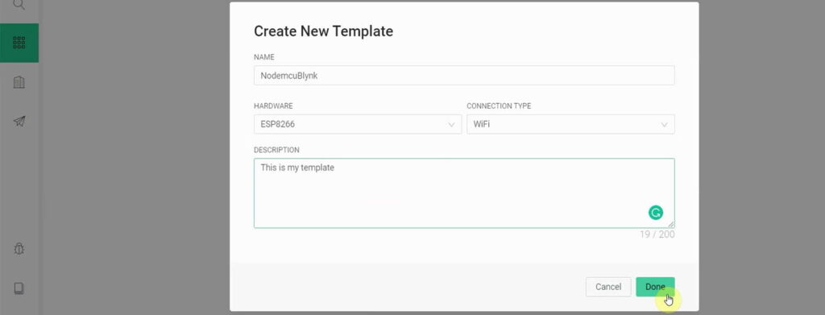
Create Blynk Template
Create Template in Blynk IoT Cloud
After login to Blynk IoT account, first you have create a template. In the dashboard click on the Templates from the left side menu.
Then click on New Template.
Select the microcontroller or board you will use in the project from the Hardware dropdown menu.
The connection type should be WiFi.
You can enter small description for the template. This field is optional.
Now click on Done.

Slide 26
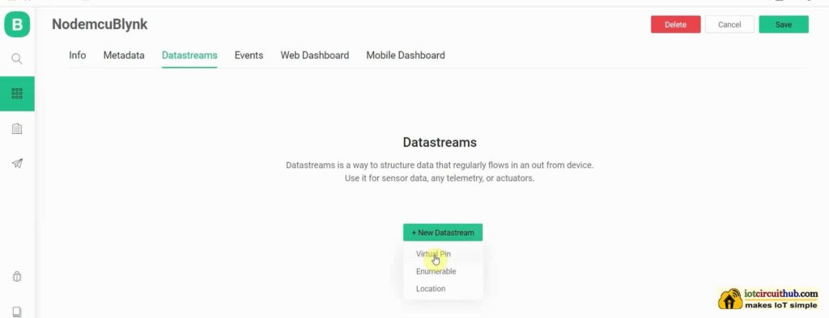
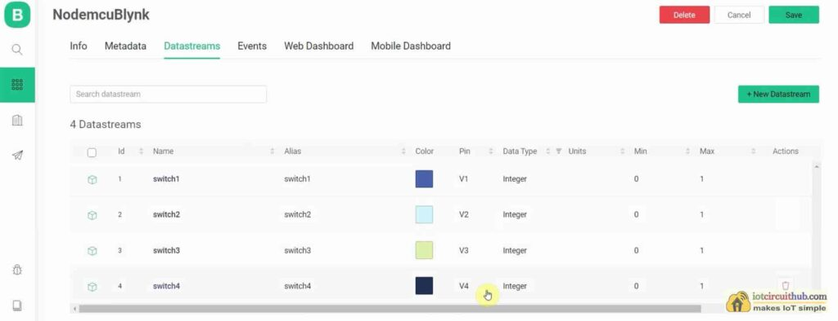
Create Datastreams in the Blynk cloud
After creating the template, go to Datastreams tab.
Then click on “New Datastream” and select Virtual Pin.
Now, you have to enter a name for this Datastream.
Select the Virtual Pin and Datatype from the dropdown menu as per the requirement.
You can also set the MAX, MIN, and default value for the datastream.
After that click on Create.

Slide 27
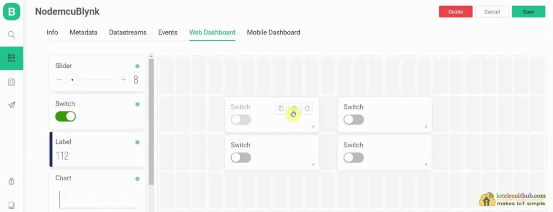
Create Web Dashboard
go to the Web Dashboard tab to add widgets.
In the dashboard, you can easily drag and drop any widgets from the left side.

Slide 28
Add Device in Blynk Cloud using Template

Slide 29
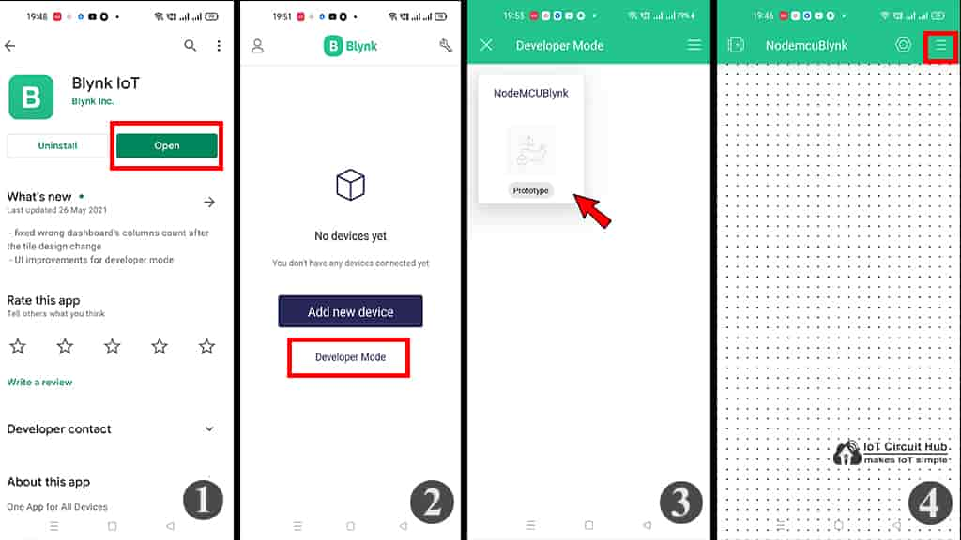
Install Blynk IoT app to set up Mobile Dashboard
Steps to install the Blynk IoT App
1. Install the new Blynk IoT app from Google Play Store or App Store. Then log in to the Blynk IoT Platform. 2. Tap on the Developer Mode. 3. Tap on the template which you have already made in Blynk cloud. 4. Now tap on the 3-dash icon (on the right) to add widgets.

Slide 30
Program NodeMCU-ESP-8266 with Arduino IDE
Install the new Blynk Library for Arduino IDE
In Arduino IDE go to Sketch — Include Library — Manage Libraries to open the Library manager.
Then search for Blynk in the search box.
Then click on Install to install the Blynk Library (Current version 1.0.0-beta.3).
After that, you can access all the Blynk Edgent examples code for ESP8266 and ESP32 from File — Examples — Blynk — Blynk.Edgent path.

Slide 31
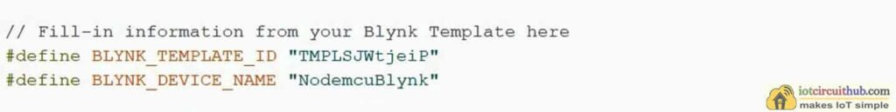
BLYNK TEMPLATE ID and BLYNK DEVICE NAME
Go to your Blynk IoT Cloud account and select the template. In the template go to the Info tab.
On the right side, you will find the BLYNK_TEMPLATE_ID and BLYNK_DEVICE_NAME for that template.
Click on “Click to copy code”, then go to Arduino IDE and paste it into the code.

